Slide 1
Concussion Protocol: Awareness, Recognition, and Progression to Return to Play
To help educate coaches on the importance of concussions, how to recognize when their players sustain a concussion, and understand how to facilitate the return to play protocol
Created by: Morgan Green, Mohammed Chehata, Andy Seraphin, Natalie McNerney, Emily Vosburg

Slide 2
Concussions impact athletes every year, causing them major setbacks in their sport and life
A concussion is a traumatic brain injury induced by biomechanical forces.
Each year, between 1.6 and 3.8 million sports-related concussions are reported in the United States
Long Term Effects of a Concussion
Post Concussion Syndrome: 10% of people develop physical, cognitive and/or emotional/behavioral symptoms that can last for weeks or months
Second Impact Syndrome: sustaining a second injury before full recovery from the first can be FATAL!!
Chronic Traumatic Encephalopathy: progressive neurodegenerative disorder related to exposure to repeated subconcussive impacts
Higher number of match hours played in the AFL associated with increased risk of sustaining a concussion
Coaches should understand the severity of concussions in order to prioritize health over missed playing time
Awareness
Recognition
Return to Play

Slide 3
Recognize the signs and symptoms of a concussion in order to your players proper medical attention
If one of your players experiences a collision and COMPLAIN OF any of the following, it is possible they have a concussion.
If one of your players experiences a collision and YOU NOTICE any of the following signs & symptoms, it is possible they have a concussion.
Headache
Dizziness
Amnesia
Poor coordination
Feels like you are “In a Fog”
Loss of consciousness
Emotional Instability
Difficulty walking or running
Poor coordination
Slow reaction time
Drowsiness
Loss of consciousness
It is in your player’s best interest, as well as the best interest of the team, for you to notify medical personnel as soon as possible. If no medical staff is available on-site, call 9-1-1.
Awareness
Recognition
Return to Play

Slide 4
If you see a player in ANY of the following positions, let medical staff or call 911 IMMEDIATELY
Emotional Instability
Difficulty walking or running
Poor coordination
Slow reaction time
Drowsiness
Loss of consciousness
It is in your teammate’s best interest, as well s the best interest of the team for you to notify your coaching staff and medical personnel as soon as possible.
Do not attempt to move the player until emergency services have arrived!
Awareness
Recognition
Return to Play

Slide 5
Conduct baseline testing annually to properly identify athletes who are safe to return to play
Baseline testing should be performed as a pre-season exam to assess an athlete’s balance and cognitive function.
According to the CDC, an athlete has returned to their baseline if they are “back to their regular activities, is no longer experiencing symptoms from the injury when doing normal activities, and has a green light from their healthcare provider to begin the return to play process.
Awareness
Recognition
Return to Play

Slide 6
After suffering a concussion, follow a Six Step Return to Play Protocol
As a coach, it is imperative that you take the appropriate precautions to safely return your players to play.
The Centers for Disease Control and Prevention (CDC) provides an established and well accepted six step return to play protocol for athletes who suffered from a concussion.
ONLY advance your player to the next step of the protocol if the player does not have any symptoms at the current step.
STEP ONE
Back to Regular Activities
Athlete is back to their regular activities. Healthcare provider has cleared them to begin the return to play process. An athlete’s return to regular activities involves a stepwise process. It starts with a few days of rest (2-3 days) and is followed by light activity (such as short walks) and moderate activity (such as riding a stationary bike) that do not worsen symptoms.
Begin with light aerobic exercise only to increase an athlete’s heart rate. This means about 5 to 10 minutes on an exercise bike, walking, or light jogging. No weight lifting at this point.
STEP TWO
Light Aerobic Activity
Awareness
Recognition
Return to Play

Slide 7
After suffering a concussion, follow a Six Step Return to Play Protocol
STEP THREE
Moderate Activity
Continue with activities to increase an athlete’s heart rate with body or head movement. This includes moderate jogging, brief running, moderate-intensity stationary biking, moderate-intensity weightlifting (less time and/or less weight from their typical routine).
STEP FOUR
Heavy, non contact activity
Add heavy non-contact physical activity, such as sprinting/running, high-intensity stationary biking, regular weightlifting routine, non-contact sport-specific drills (in 3 planes of movement).
STEP FIVE
Practice and Full Contact
Athlete may return to practice and full contact in controlled practice.
STEP SIX
Competition
Athlete may return to competition.
Awareness
Recognition
Return to Play

Slide 8
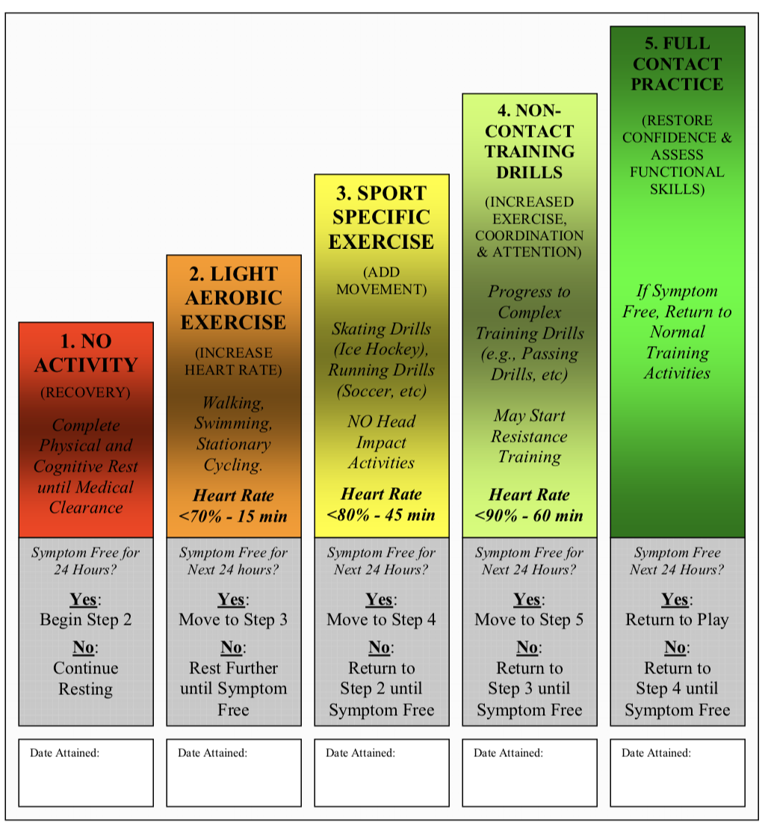
A visual representation of an athlete’s return to play after suffering a concussion
If your player has sustained a concussion, this is the expected progression that you engage them in before they can return to play. Please ask your medical staff for advice if you have any questions or concerns regarding this process.
Reference: Consensus Statement on Concussion in Sport: the 3rd International Conference on Concussion in Sport held in Zurich (2008), Br J of Sports Med 2009; 43: i76-i84 doi:10.1136/bjsm.2009.058248
Awareness
Recognition
Return to Play

Slide 9
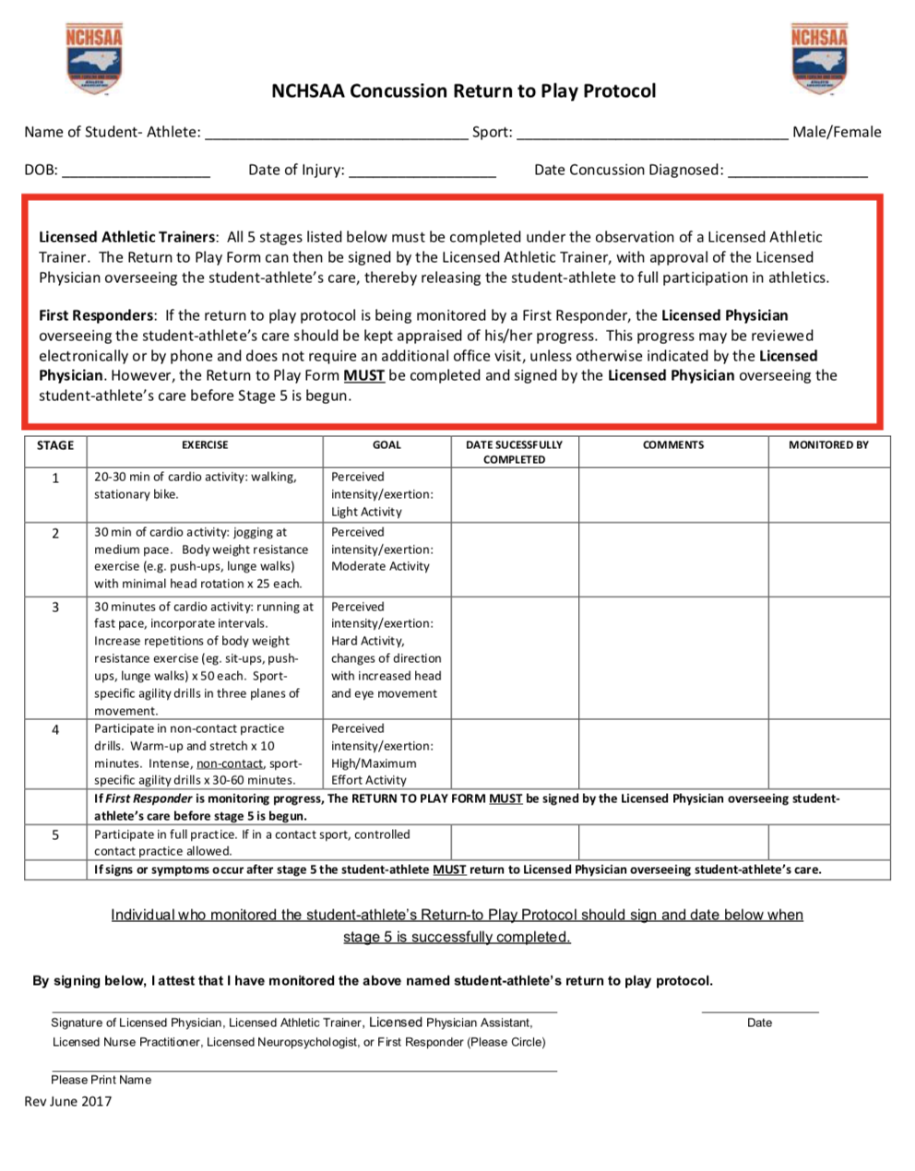
Example: Concussion Return to Play Protocol
This is an example of the concussion protocol form from the North Carolina High School Athletic Association. It allows coaches to track a player’s progress after a concussion and allows players to anticipate the next steps in their recovery. This could be utilized by the USAFL coaches to monitor an athlete’s return to play.
Please refer to https://www.nchsaa.org/sites/default/files/attachments/NCHSAAConcussionRTPProtocol.pdf
for the full document
Awareness
Recognition
Return to Play

